Slide 1

INSTITUTE: UIE (AIT-CSE)
Computer Networks CST- 348
Lecture - 1 .1,1.2,1.3,1.4,1.5
Basics of Computer Networks,categories of network
By : Dr. Monica Luthra(e9836)
DISCOVER . LEARN . EMPOWER

Slide 2

Course Objectives
CO Number | Title
CO1 | Describe the important networking concepts
CO2 | Understand concept of network reference models and protocols
CO3 | Apply the concepts of routing algorithms on various networks
CO4 | Identify mechanism to handle traffic and control on congestion
CO5 | Identify and understand connection establishment techniques and features

Slide 3

Course Outcomes
After this course student will be able to:
To bring together several key of Computer network design and architecture
To Familiarize the student with the basic taxonomy and terminology of the computer networking area.
To Allow the student to gain expertise in some specific areas of networking such as the design and maintenance of individual networks.

Slide 4

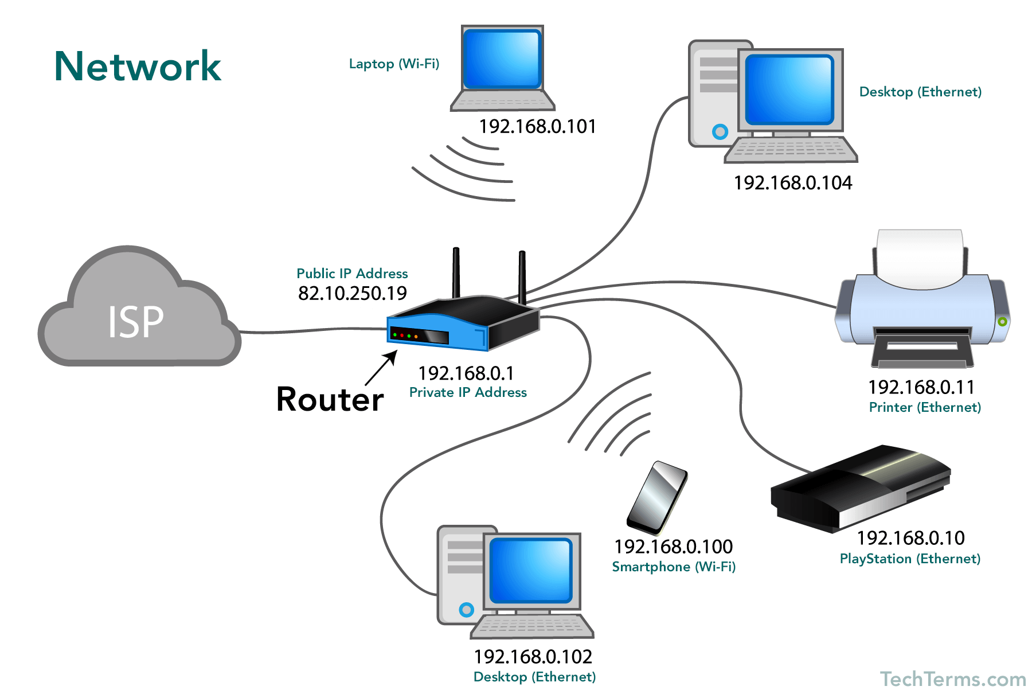
What is a Network?
A network is a collection of computers, servers, mainframes, network devices, peripherals, or other devices connected to one another to allow the sharing of data.
An excellent example of a network is the Internet.
Image Source : https://www.geeksforgeeks.org/basics-computer-networking/

Slide 5
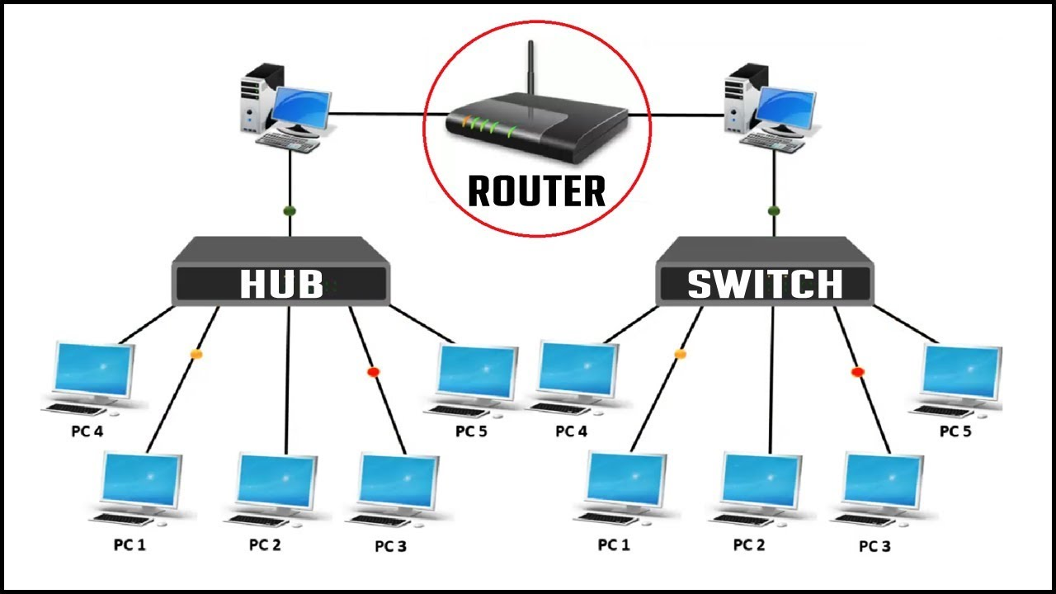
Network Types
SOHO : Small office, Home office
Enterprise Network : Having Many Devices
For example we talk a Company , Bank
Image Source : https://www.geeksforgeeks.org/basics-computer-networking/

Slide 6
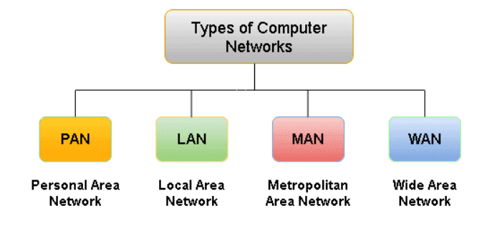
Types of Computer Networks
There are different types of (private) networks depending on their size (in terms of the number of machines), their data transfer speed, and their scope. Private networks are networks belonging to the same organization. There are generally four categories of networks:

Slide 7
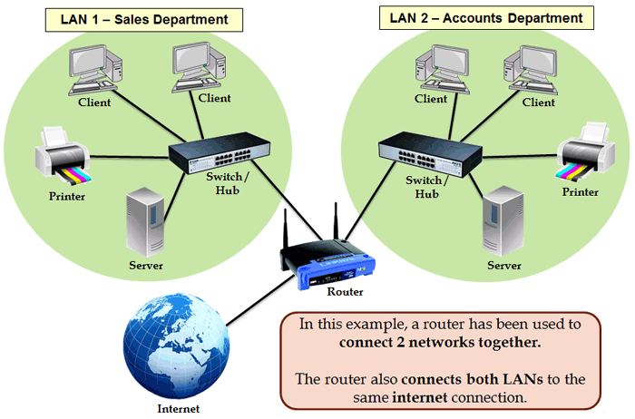
LAN (Local Area Network)
It is a set of computers belonging to the same organization and linked together in a small geographical area by a network, often using the same technology (the most common is Ethernet).
Early LAN’s had data rates in the 4 to 16 Mbps range. Today, speeds are normally 100 or 1000 Mbps. Propagation delay is very short in a LAN.
The size of a local network can reach up to 100 or even 1000 users.
Image Source: https://www.tutorialspoint.com/data_communication_computer_network/computer_network_types.htm

Slide 8
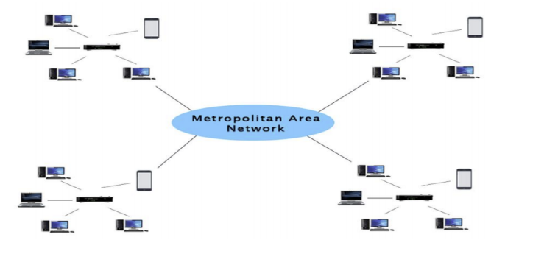
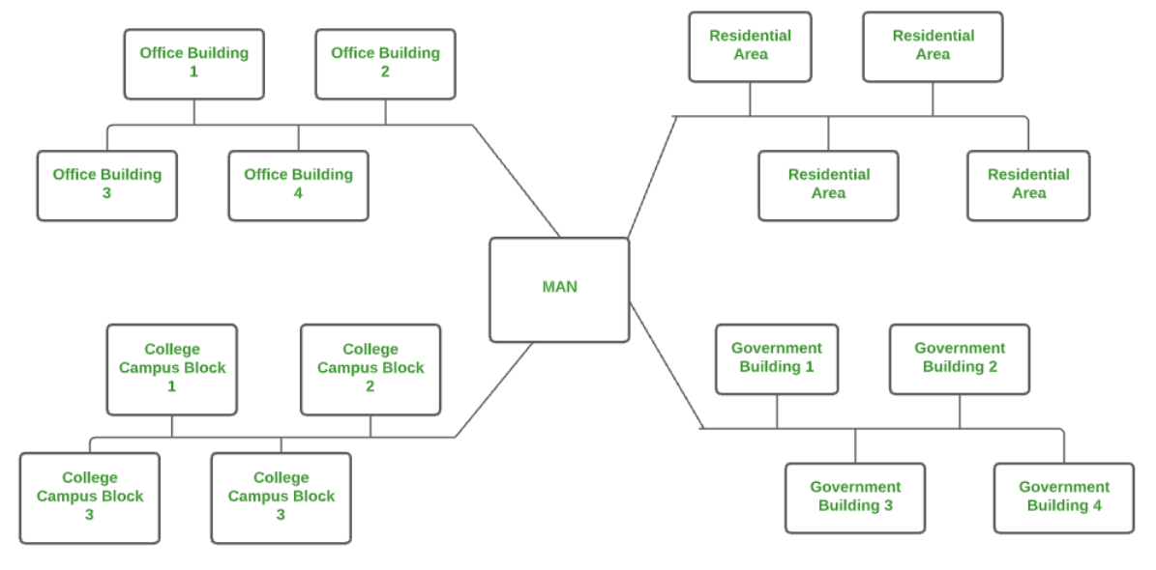
MAN( Metropolitan Area Network)
A Metropolitan Area Network or MAN is consisting of a computer network across an entire city, college campus, or a small region.
This type of network is large than a LAN, which is mostly limited to a single building or site. Depending upon the type of configuration, this type of network allows you to cover an area from several miles to tens of miles.
A MAN is often used to connect several LANs together to form a bigger network. When this type of network is specifically designed for a college campus, it is sometimes referred to as a campus area network, or CAN.
Government agencies use MAN to connect to the citizens and private industries.
Examples of a MAN are the part of the telephone company network that can provide a high-speed DSL line to the customer or the cable TV network in a city.
Ethernet (10 Mbps) or Fast Ethernet (100 Mbps), and a few locations have Gigabit Ethernet (1000 Mbps) connections
Image Source: https://www.tutorialspoint.com/data_communication_computer_network/computer_network_types.htm

Slide 9
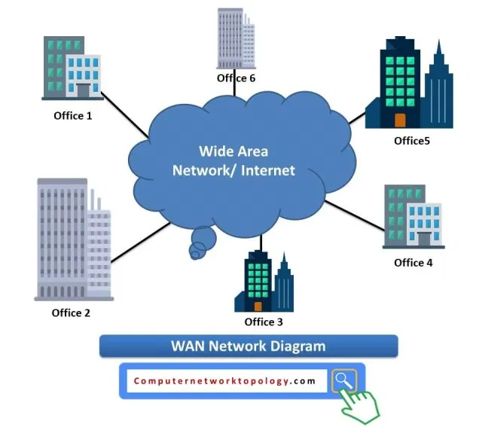
WAN ( Wide Area Network)
WAN is a type of computer network that connects computers over a large geographical distance through a shared communication path.
It is not restrained to a single location but extends over many locations.
WAN can also be defined as a group of local area networks that communicate with each other.
The most common example of WAN is the Internet.
Current Wide Area Networks runs on bandwidths of 20 Mbps, 50 Mbps or 100 Mbps
Image Source: https://www.tutorialspoint.com/data_communication_computer_network/computer_network_types.htm

Slide 10
Key Points
Data communications are the transfer of data from one device to another via some form of transmission medium.
A data communications system must transmit data to the correct destination in an
accurate and timely manner.
Text, numbers, images, audio, and video are different forms of information.
Data flow between two devices can occur in one of three ways: simplex, half-duplex, or full-duplex.
In a point-to-point connection, two and only two devices are connected by a
dedicated link. In a multipoint connection, three or more devices share a link.
Topology refers to the physical or logical arrangement of a network. Devices may be arranged in a mesh, star, bus, or ring topology.
A network can be categorized as a local area network or a wide area network.
There are local, regional, national, and international Internet service providers.
A protocol is a set of rules that govern data communication; the key elements of a protocol are syntax, semantics, and timing

Slide 11
References
https://www.geeksforgeeks.org/basics-computer-networking/
https://www.youtube.com/watch?v=VwN91x5i25g&list=PLBlnK6fEyqRgMCUAG0XRw78UA8qnv6jEx
http://www.svecw.edu.in/Docs%5CCSECNLNotes2013.pdf
https://www.cloudflare.com/learning/ddos/glossary/open-systems-interconnection-model-osi/

Slide 12
THANK YOU
For queries
Email: monica.e9836@cumail.in

